Slide 1
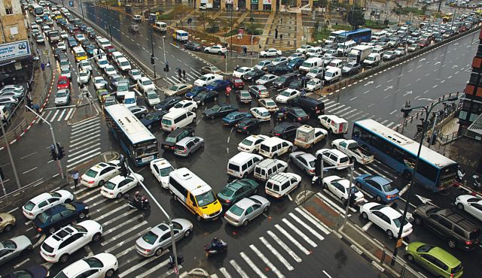
A Non-homogeneous Time Mixed Integer LP Formulation for Traffic Signal Control
Iain Guilliard, Scott Sanner, Felipe Trevizan, Brian Williams
Notes:
1. Title Slide: I'm going to talk about recent progress in how to globally optimize traffic signals using MILPS.

Slide 2
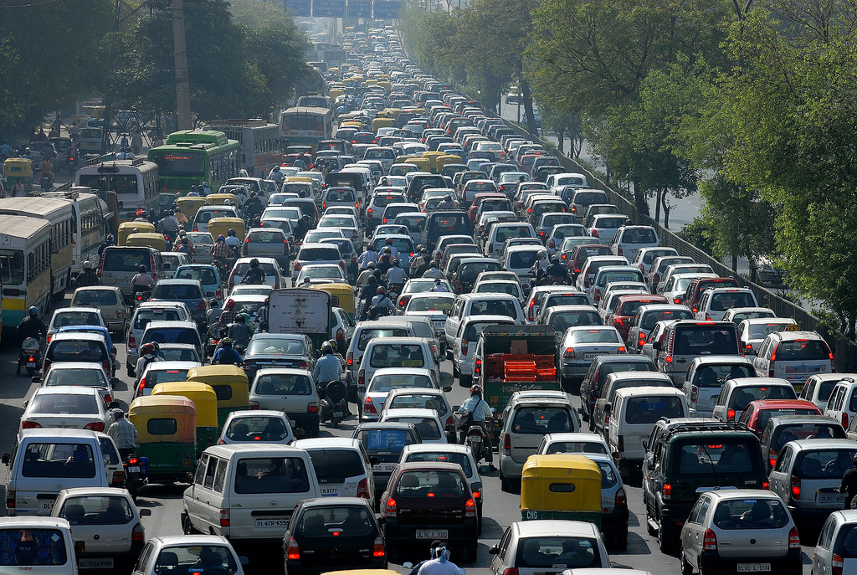
Motivation
Notes:
Fixed plan:
- not adaptive to changes in traffic
- fixed objective: worst case or average, etc
Adaptive:
- old - from 1960's
- reactive rather than predictive

Slide 3
Control methods
Suboptimal
Fixed Time Control
Adaptive Control: e.g. SCOOT and SCATS
Good: scalable
Bad: no performance guarantee
Locally optimal:
e.g. SURTRAC
Good: decentralized control
Bad: myopic
Globally optimal
e.g. CTM, LTM
Good: best solution possible
Bad: scalability
Notes:
3. Fixed-time: in practice, different plans for different times of day + actuation.

Slide 4
In this work
We present the Queue Transmission Model that:
Is globally optimal
We take advantage of the new developments in MILP solvers
Allows arbitrary topology
Grids and asymmetric intersections
Scales to many intersections
We use non-homogenous time steps to decrease the size of the problem

Slide 5
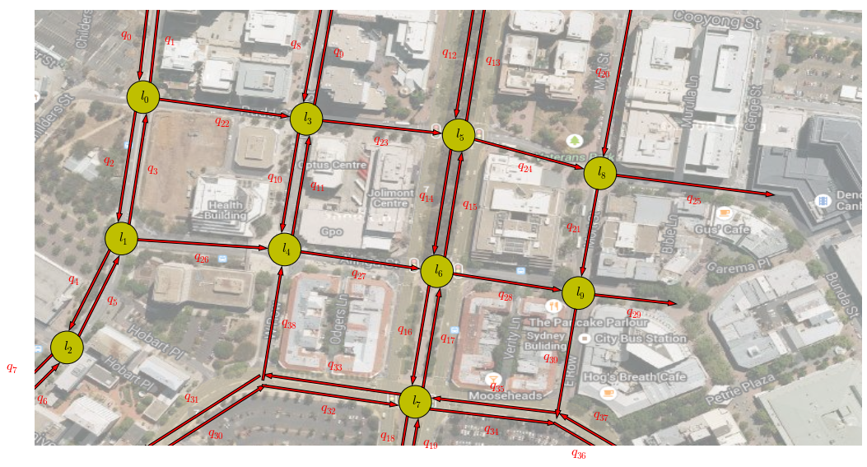
Homogeneous vs Non-Homogeneous
Time discretization:
Homogenous: uniform
Non-homogenous: arbitrary
Advantages of non-homogeneous:
Increase spatial horizon
Offers fidelity trade off
Non-Homogeneous
Homogeneous

Slide 6
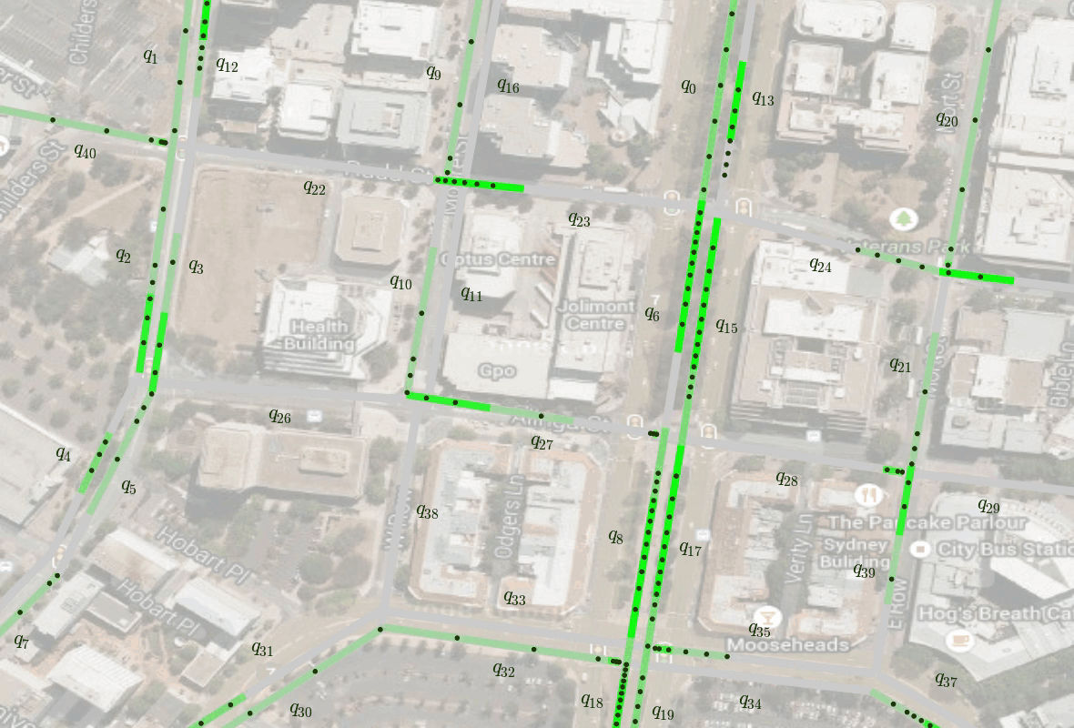
QTM Example

Slide 7
QTM Example – Queuing Behaviour

Slide 8
QTM Example – Platoons

Slide 9
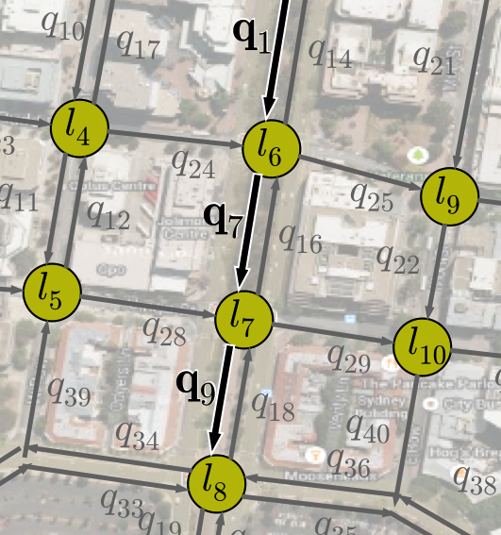
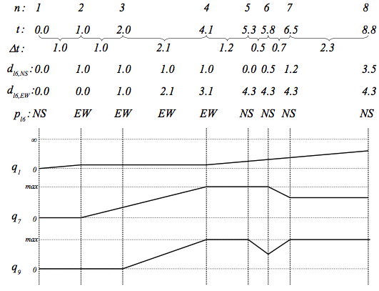
QTM - Variables

Slide 10
QTM - Variables

Slide 11
QTM - Variables

Slide 12
QTM - Variables

Slide 13
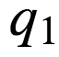
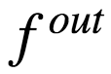
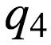
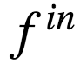
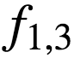
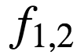
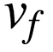
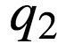
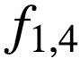
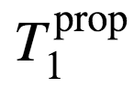
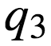
The Queue Transmission Model: QTM
F
I
F
O

Slide 14
QTM - dynamics
Link
traffic state
v_{f}
queue at light
platoon
QTM
CTM
3 cells
c₁
c₂
c₃
CTM
9 cells
c₁
c₂
c₃
c₄
c₅
c₆
c₇
c₈
c₉

Slide 15
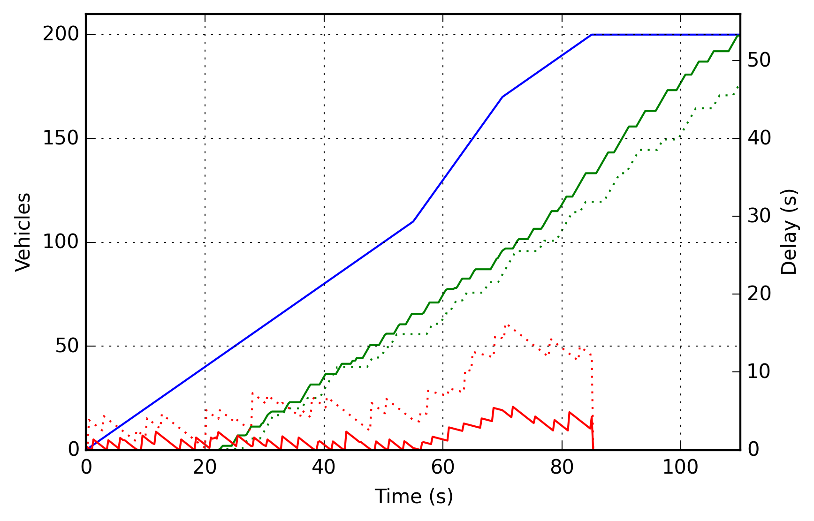
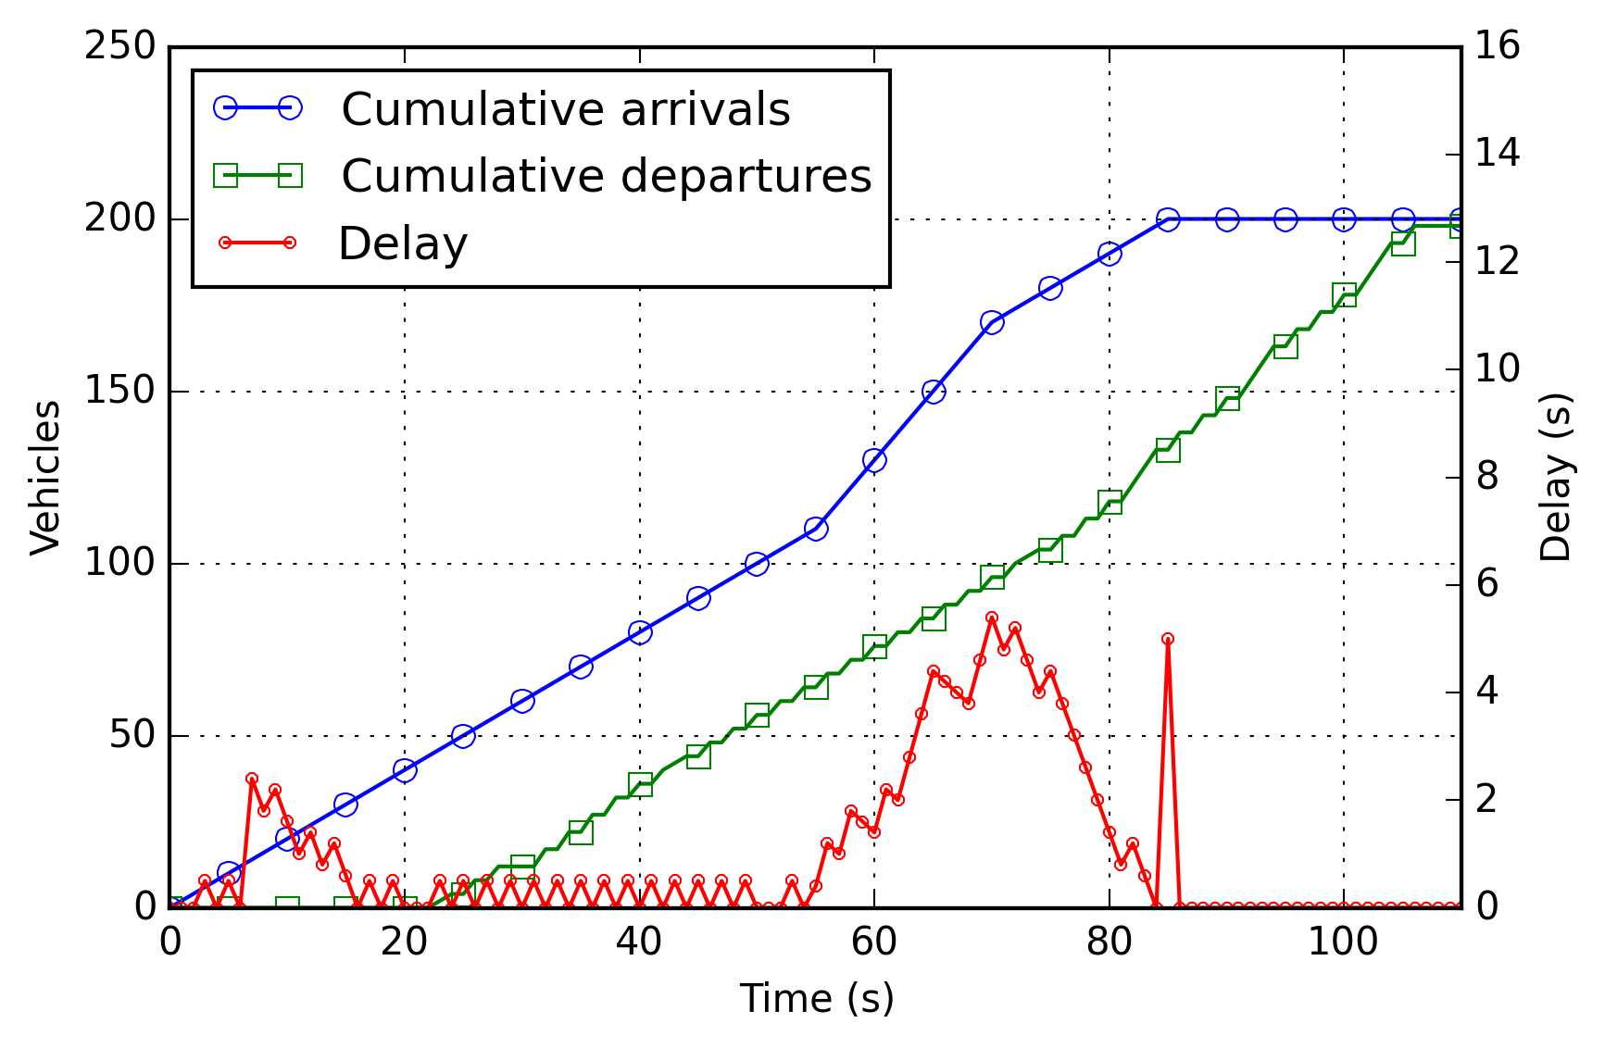
Objective Function
Travel Time
Out flow
In flow
Delay

Slide 16
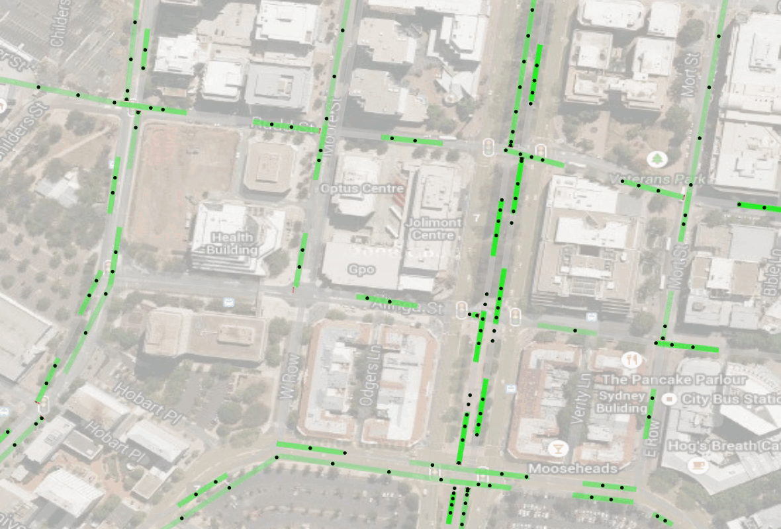
QTM Example: Optimized control

Slide 17
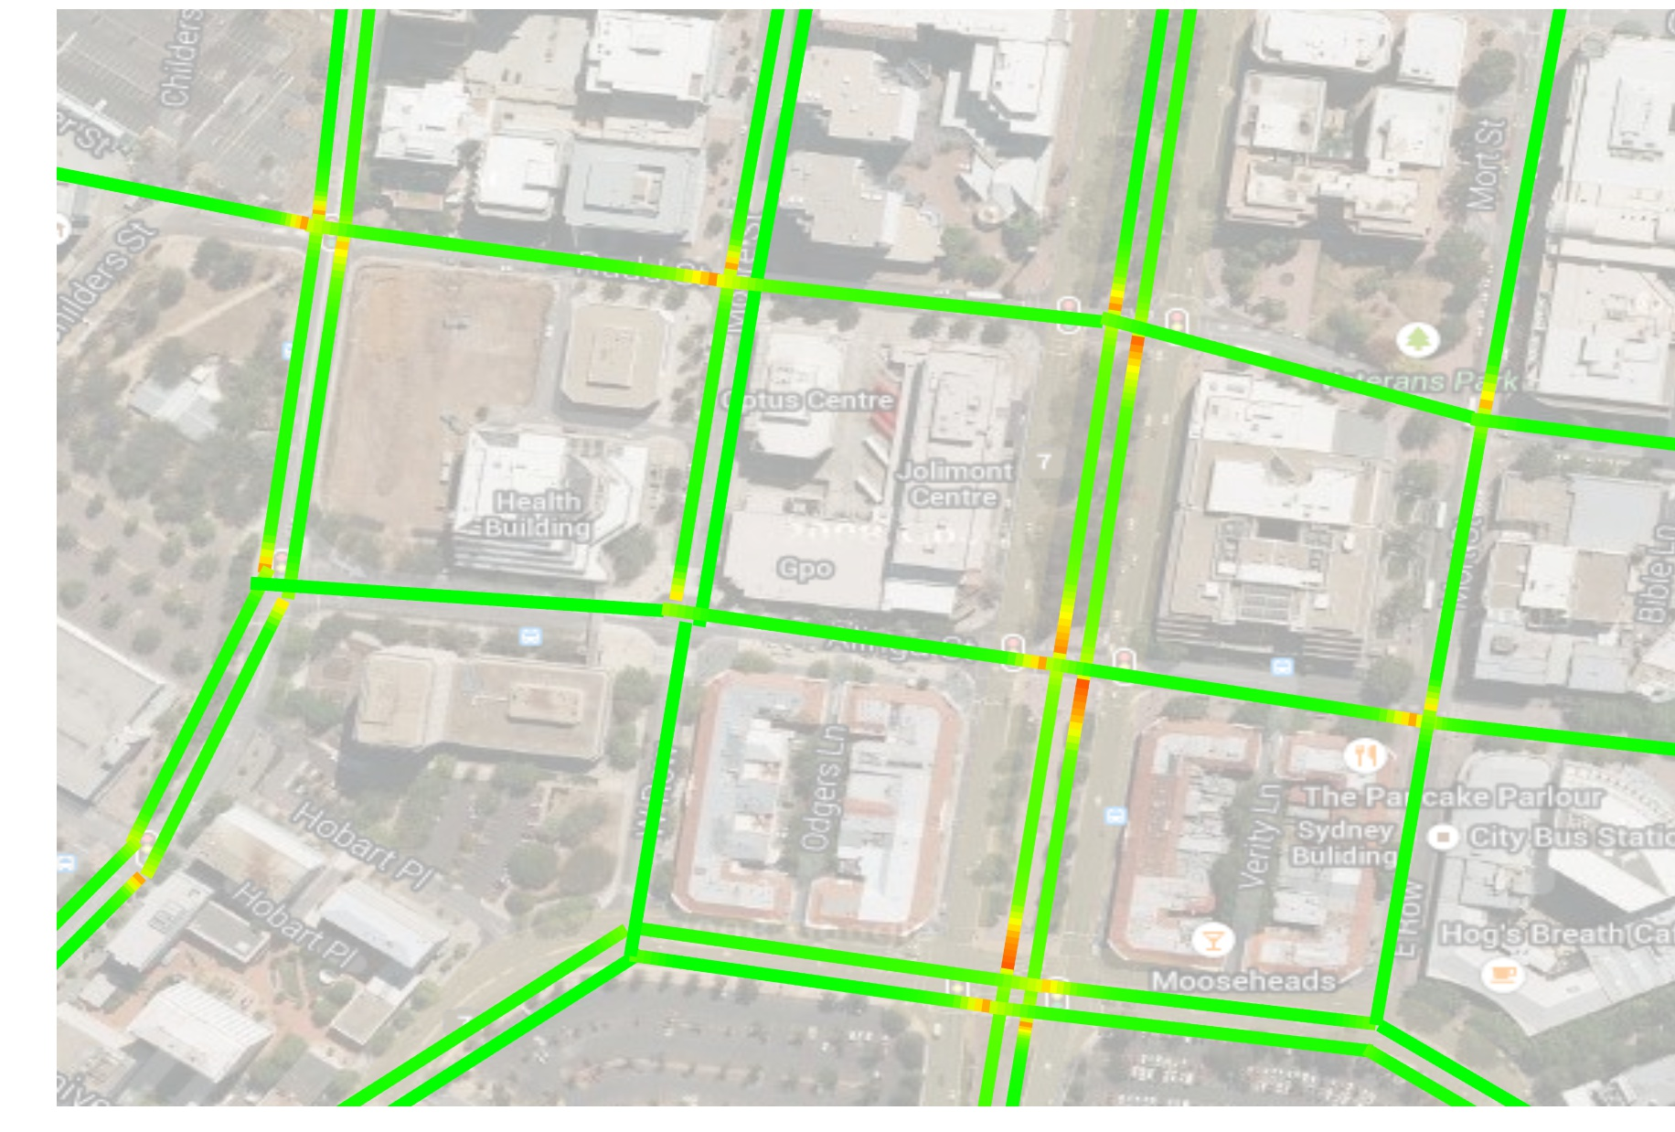
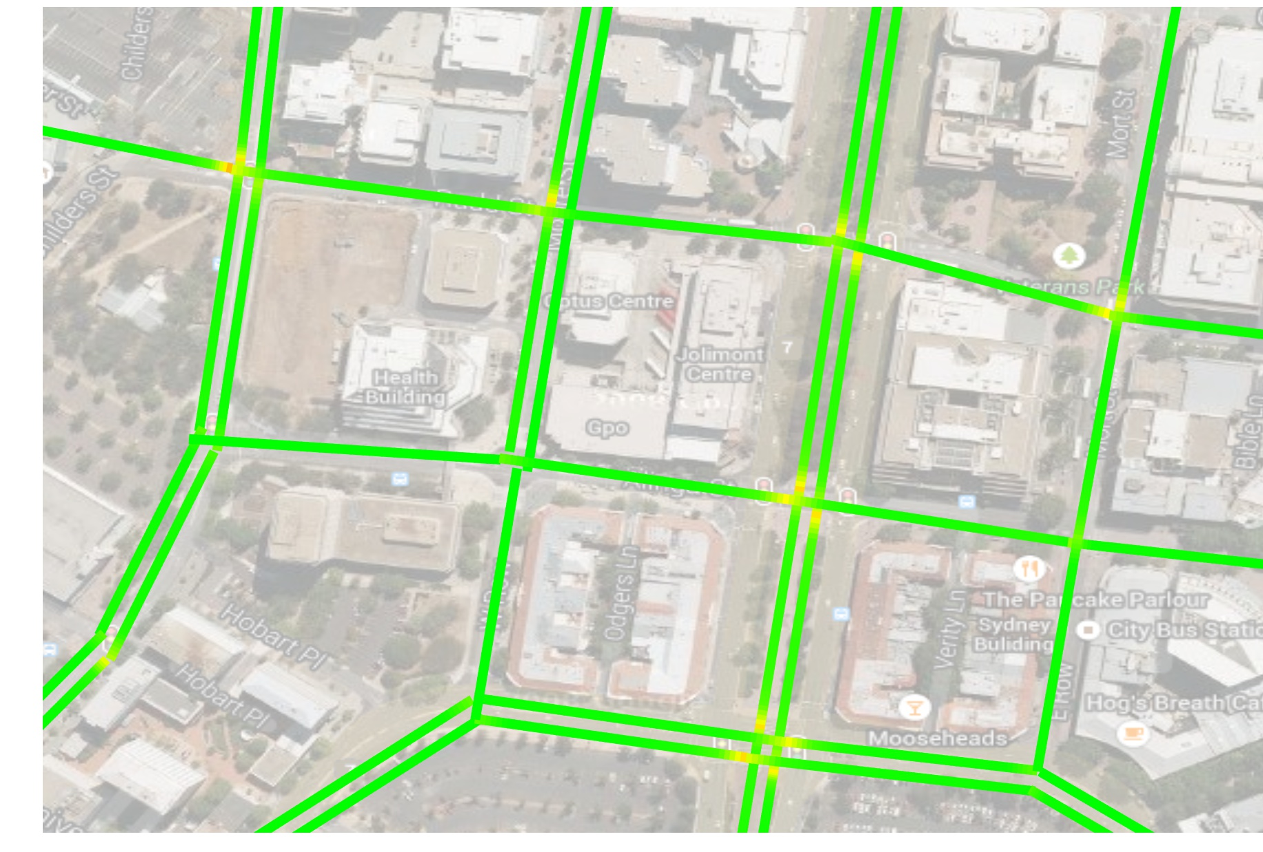
QTM - Fixed vs Optimized Signal Plan
Fixed
QTM Optimized

Slide 18
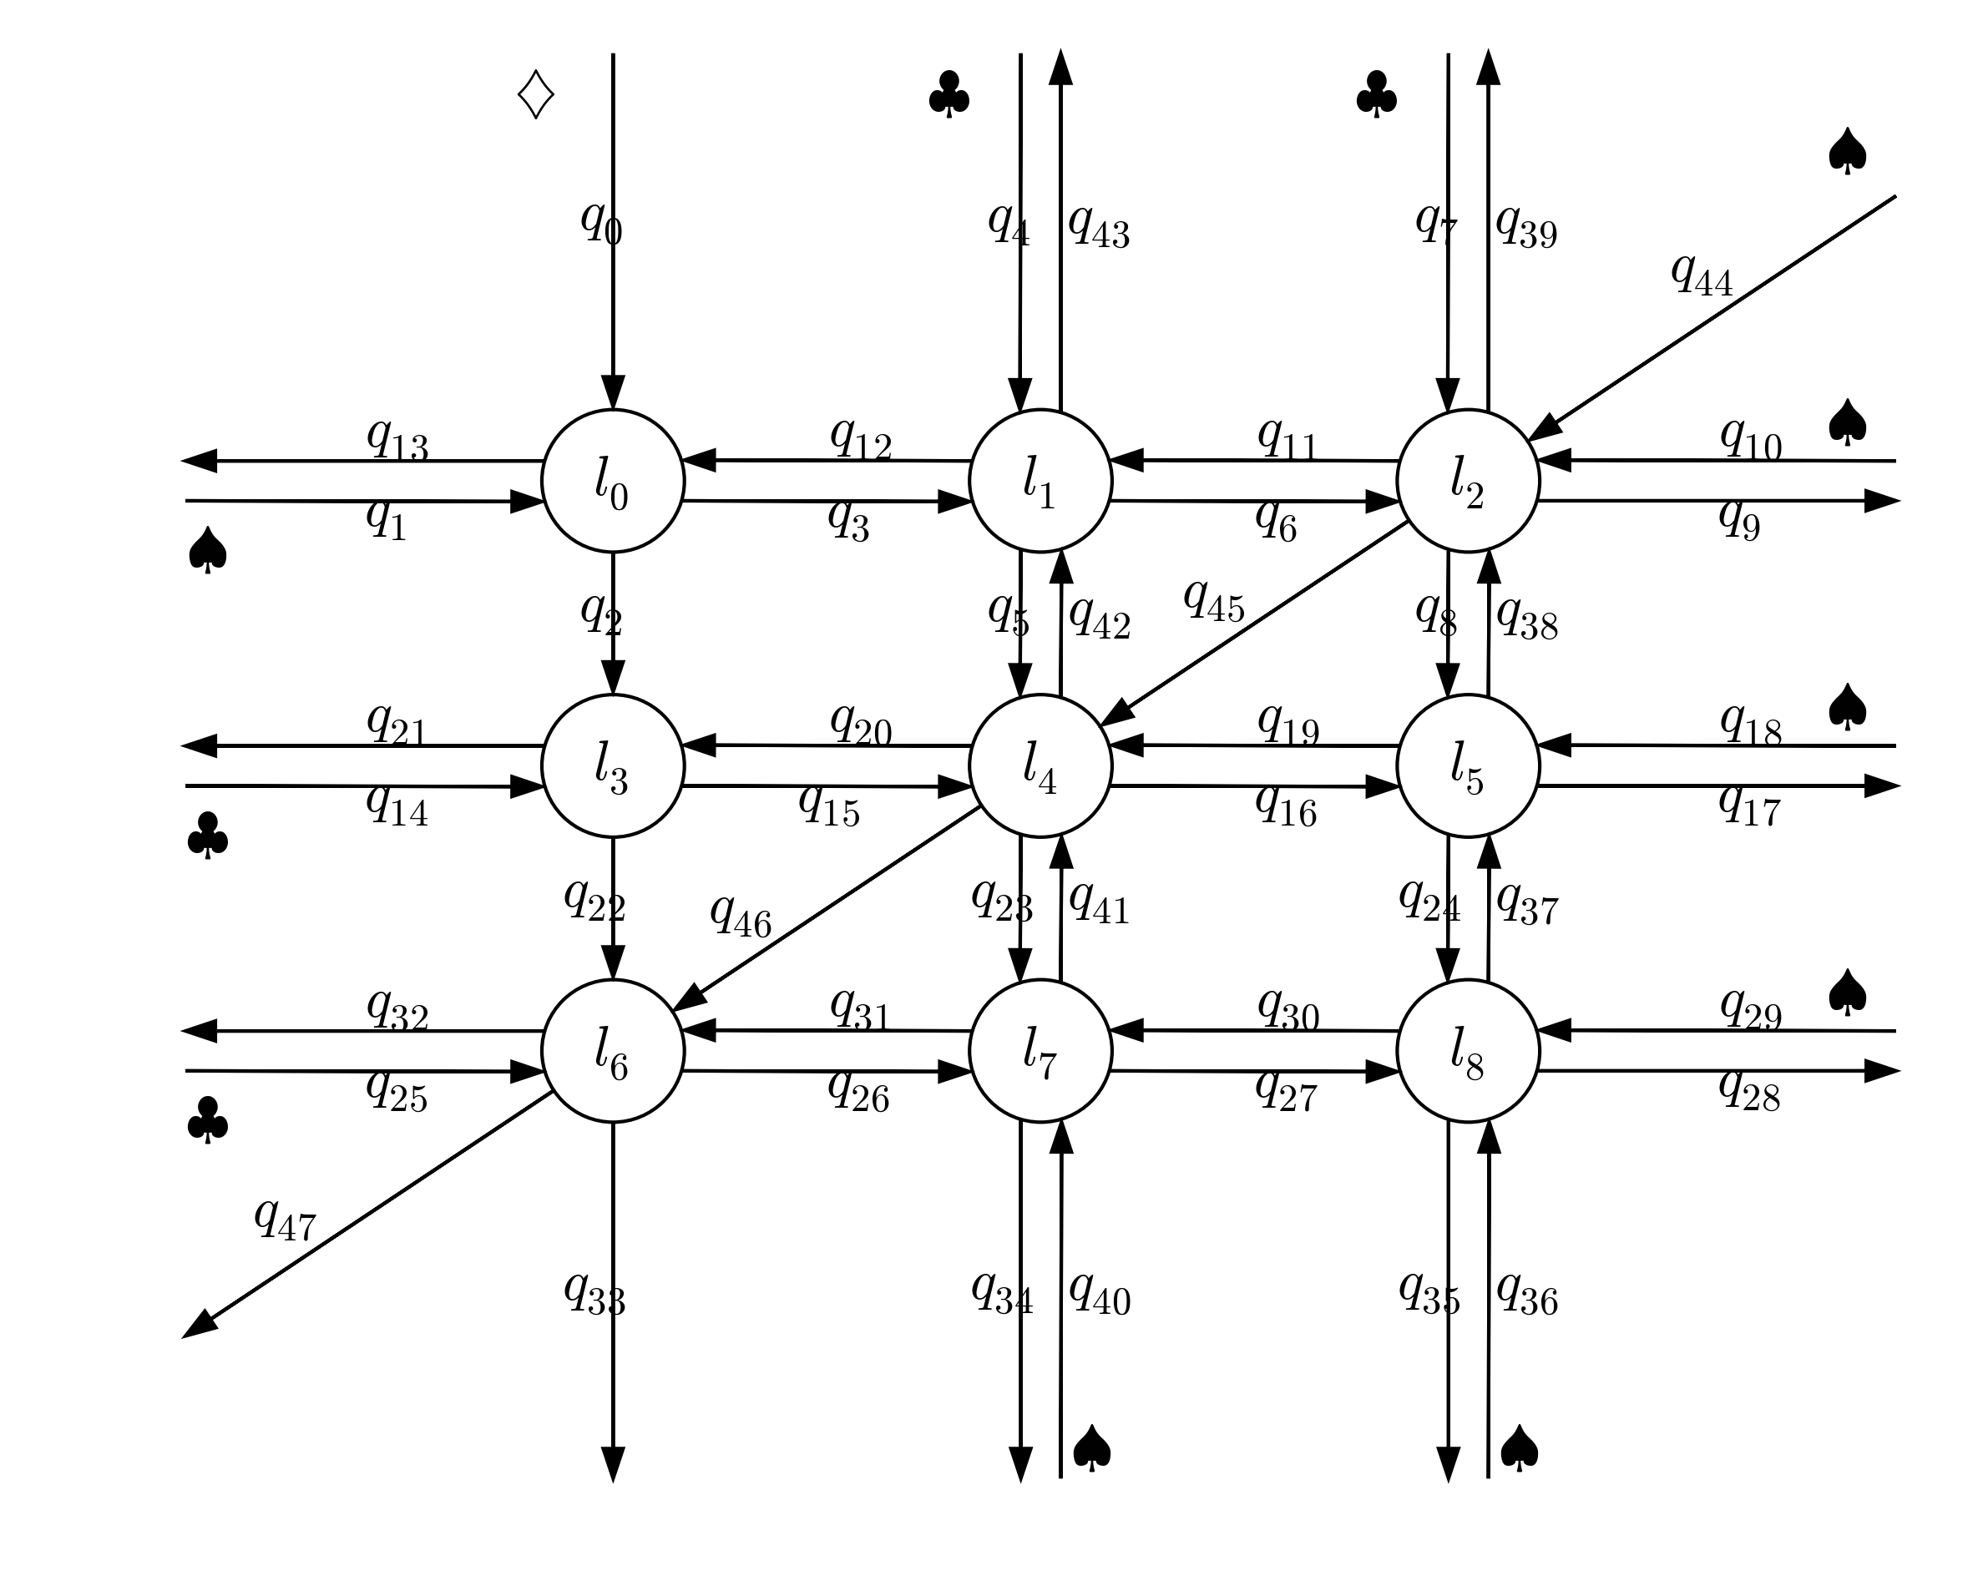
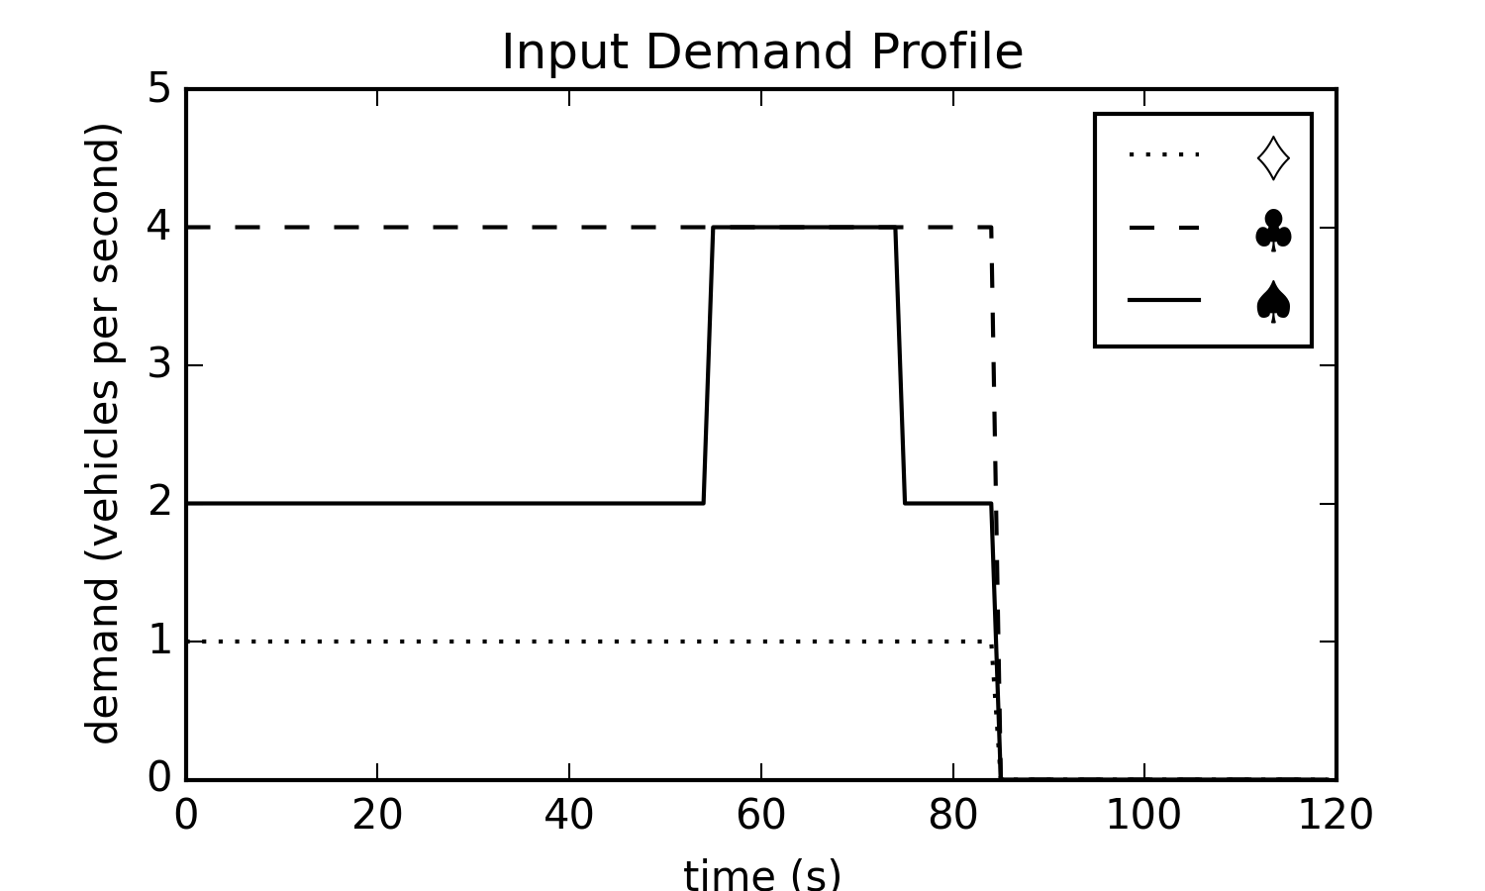
Experiments - networks

Slide 19
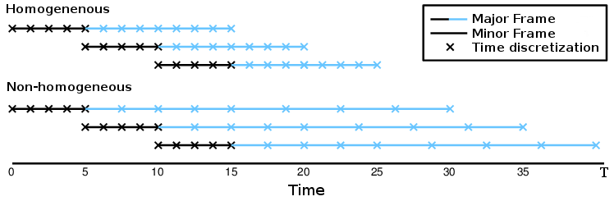
Experiments – receding horizon control

Slide 20
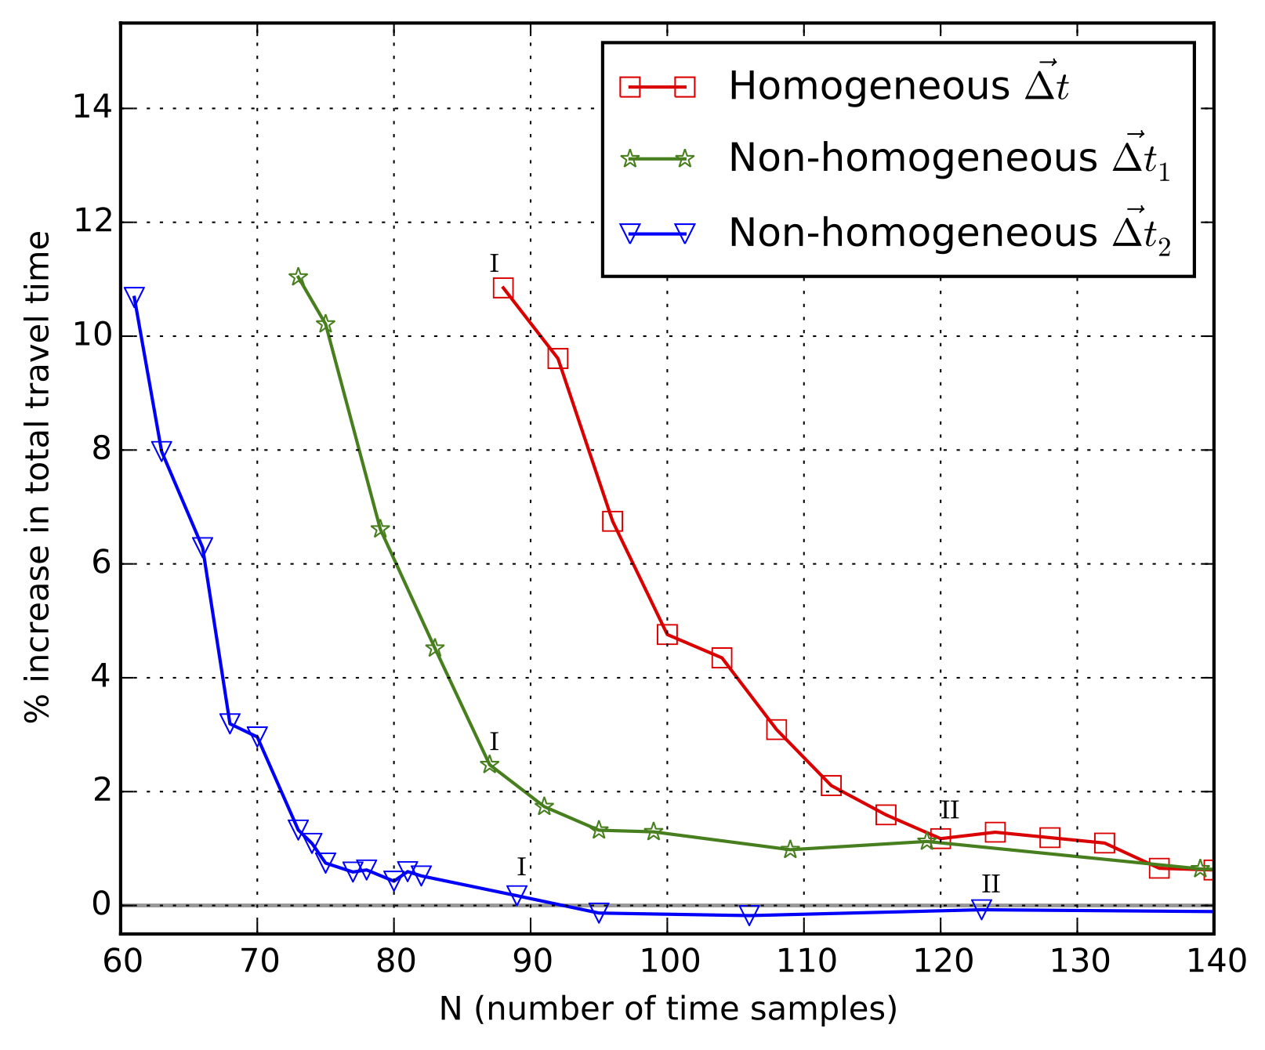
Results - Convergence
Increasing travel time
Non-
Homogeneous
Homogeneous
Non-
Homogeneous
Time samples / planning horizon

Slide 21
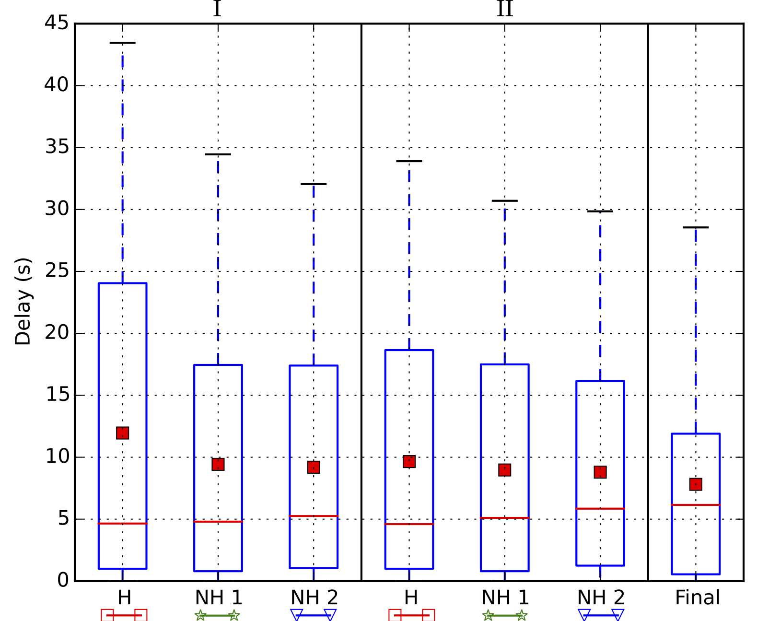
Results - Quality
F
Increasing travel time
Time samples / planning horizon

Slide 22
Conclusion
Presented Queue Transmission Model (QTM)
Globally optimal
Allows arbitrary topology
Scales to many intersections
Main insight: non-homogenous time discretization
Compared to homogeneous solution:
Faster convergence
Same or better solution quality
Notes:
Compare optimized plans with SCATS/SCOOT to see if there is a better heuristic

Slide 23
Future Work
Close the loop
Learn parameters from data
Add Extensions:
Light rail
Uncontrolled intersections
Code on Github:
github.com/iainguilliard/QTM_Traffic_Model
Notes:
Compare optimized plans with SCATS/SCOOT to see if there is a better heuristic

Slide 24
Thank you!
Questions?

Slide 27
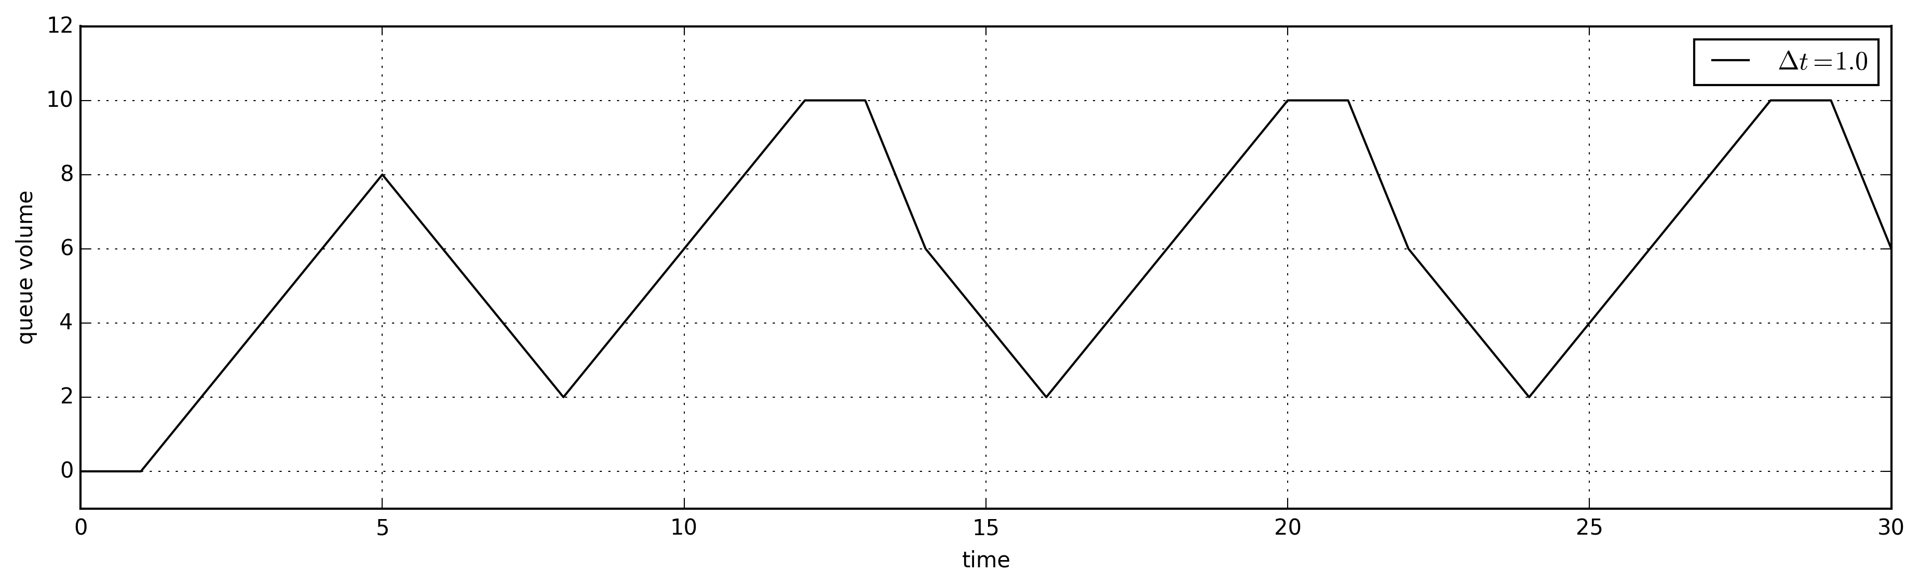
Integration V(x,y)

Slide 28
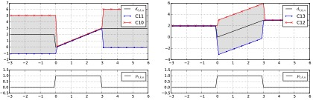
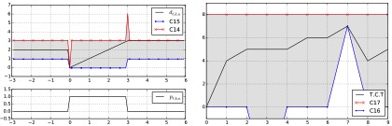
Phase Duration Control
Ramp
Hold
Reset
Cycle time

Slide 29
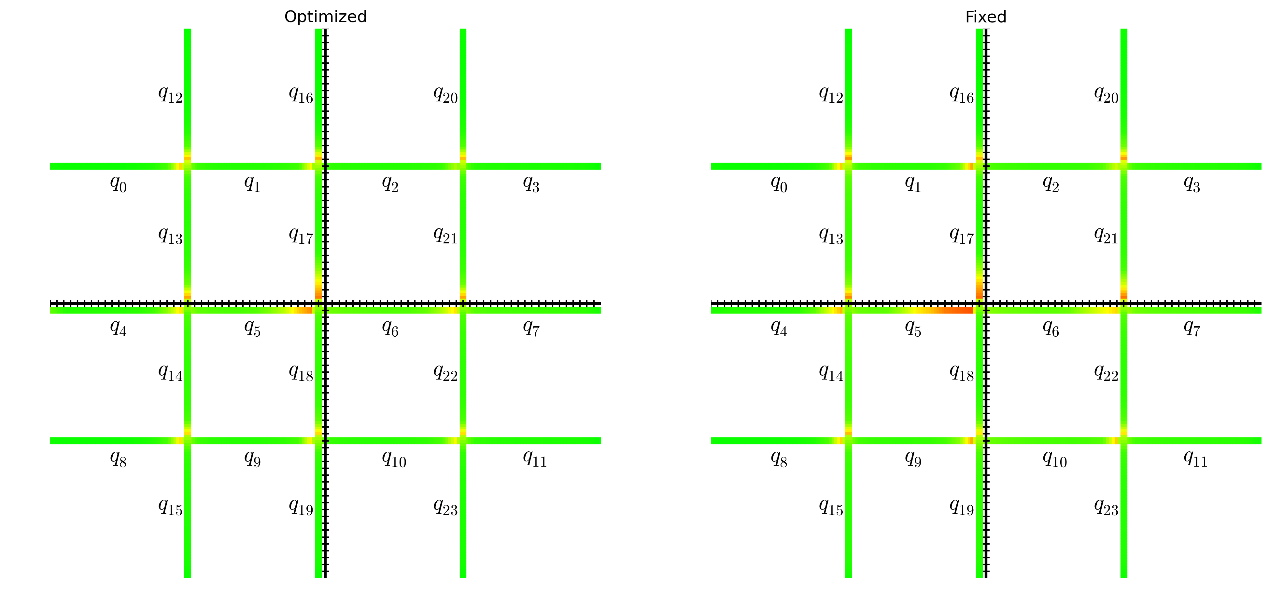
Delay Heat Map 3400 vph

Slide 30
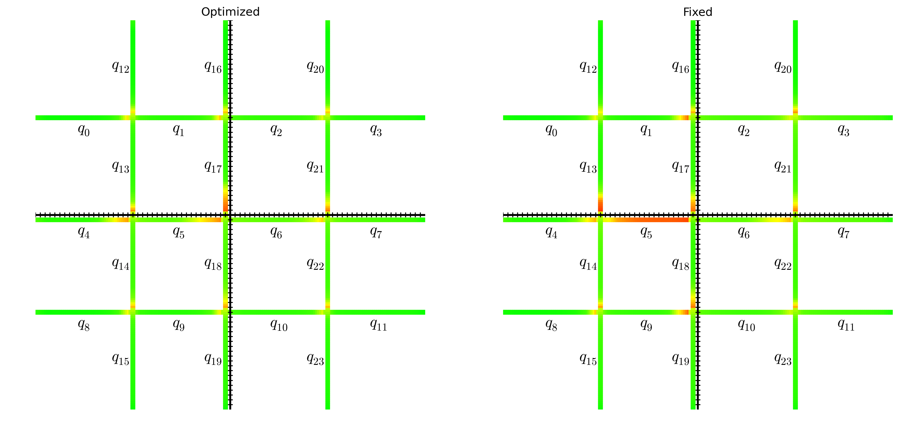
Delay Heat Map 4300 vph

